Slide 1
IES CLARA DEL REY
MULTIPLIER EVENT 20th December 2023

Slide 2
ENLACE A LA PRESENTACIÓN:
https://iesclaradelrey.es/erasmus/?p=1202

Slide 3
Wednesday , December the 20th 2023
10:00: Welcome and Registration
10:30: What does DIGIT project mean?
Project presentation
International students’ meeting
Results presentation: Open resources for companies, students and teachers to improve SME digitalisation
11:30 PREDIF presents its new Erasmus + project
11:45 Coffee break
12:15 Satisfaction questionnaire

Slide 4
Principal Welcome
Our principal, Mercedes Rodríguez Villafafila will welcome everybody to our event.
VIDEO 1 IES CLARA DEL REY I

Slide 5
ERASMUS+ IN IES CLARA DEL REY
We are engaged in the Erasmus Program since 2007 and in the Erasmus+ Program since 2014. IES Clara del Rey holds an Erasmus Charter and, since 2022, an Erasmus+ Accreditation in VET allowing our student and staff to implement high quality mobility activities
In regard to the Erasmus+ Program one of our main goals is
providing our students with quality training placements abroad.

Slide 6
ERASMUS+ IN IES CLARA DEL REY
We have develop an internationalization plan to:
Implement teachers and students´ educational mobilities, promoting inclusion and respecting the principles of equity.
Encourage our students to participate actively in European programs, as well as foster the feeling of "European citizens" through total immersion in the society of another European country and in the professional field of their studies in the destination country.
Improve the linguistic and communicative participants’ skills
Implement our College internationalization plan through cooperation actions with partners European Schools and companies to promote the learning of students and teachers, through quality agreements.

Slide 7
Get a better knowledge for the students to integrate into the labour market
Facilitate our students' a personal development such as the ability to adapt to new situations and self-confidence
In order to achieve these objectives, we have implemented several Erasmus+ projects:

Slide 8
Proyecto: 2022-1-ES01-KA122-VET-000079227
Proyecto: 2022-1-ES01-KA131-HED-000057325
Proyecto: 2022-1-ES01-KA131-HED-000057325
Proyecto: 2023-1-ES01-KA121-VET-000125730
Proyecto: 2023-1-ES01-KA131-HED-000125788
DIGIT: 2021-1-DE02-KA220-VET-000034657

Slide 9
WHAT DIGIT PROJECT MEANS: PROJECT PRESENTATION
Key Action: Cooperation among organisations and institutions:
DEUITALIENISCHE HANDELSKAMMER FÜR TSCHLAND E.V. (ITKAM),
PLATAFORMA REPRESETATIVA ESTATAL DE DISCAPACITADOS FISICOS ASOCIACION (PREDIF)
BERUFSSCHULE FÜR DEN GROßHANDEL, AUßENHANDEL UND VERKEHR (BSGAV)
LYCÉE RAIMOND NAVES (LRN)
IES CLARA DEL REY (ICR)
F6S NETWORK IRELAND LIMITED (F6S)

Slide 10
OBJECTIVES
The DIGIT project aims at providing people that during their daily activities promote the internationalization of EU SMEs in agro-food value chain, with relevant skills, knowledge, competences and tools to drive an inclusive digital transformation of the internationalization process. Specifically, the project will enhance opportunities to best incorporate digital technologies into subject-specific teaching, training and learning, adapting competences to face the digital transformation of the internationalization process using DigComp 2.1 as reference framework.

Slide 11
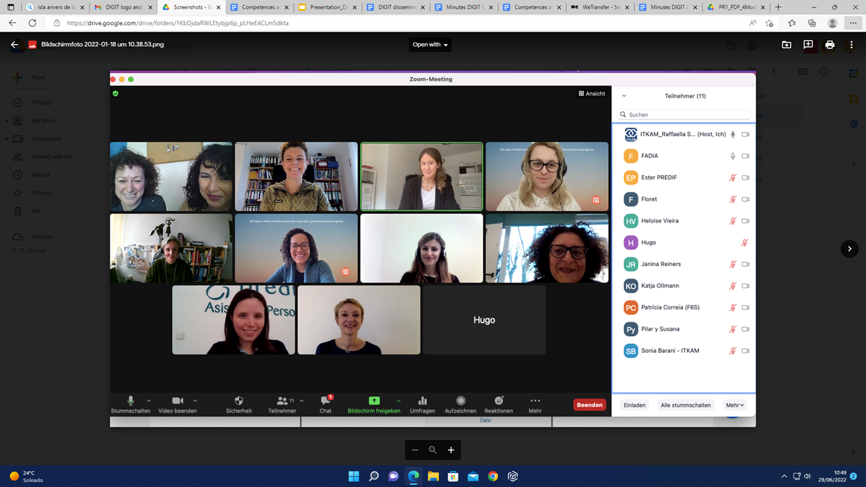
OUR HISTORY
The DIGIT KICK OFF MEETING – JANUARY 2021

Slide 12
OUR HISTORY
The DIGIT KICK OFF MEETING – JANUARY 2021
The question:
What do we have to do?

Slide 13
OUR CONTRIBUTION
IES CLARA DEL REY:
is responsible for the development of PR2 (Toolkit Accessible Digital Marketing Techniques) and will cooperate with the other partners in the realization of the other PRs as well as in the dissemination and exploitation activities.
ICR will moreover be responsible for selecting VET learners and trainers for participation in the LTTA1 and in the piloting of
the project results.
will also collaborate with PREDIF in the realization of the Multiplier Event in Spain.

Slide 14
OUR HISTORY
Many virtual meetings and a lot of work after the kick off meeting.
The first Learning Transnational meeting in Madrid
September 2022

Slide 15
Transnational Project Meeting MADRID
Welcome to IES Clara del Rey

Slide 16
Thursday 22nd September 2022
09.30 Welcome to IES Clara del Rey
Some of our students will help register the attendees
Partners will meet our Principal and some teachers
We’ll enjoy a coffee or soft drinks
09: 45 Conference room: Presentation of the State of the Art (ITKAM)
10:30 Coffee break
11:00 Round table meeting: Exchanging opinions about the materials which have been produced up to now

Slide 17
11:05 Module 1 : PREDIF
11: 35 Module 2 : ITKAM
12:10 Module 3 : BSGAV and Lycée Raymond Naves
12: 35 Module 4: F6S

Slide 18
Thursday 22nd September2022
13:00 Lunch at Perretxico Restaurant
14:15 Conference room: Presentation of the testers’ database and of a selection strategy (F6S)
15:15 : Coffee break
15:30: Presentation of the questionnaire about PR1 to be submitted to the testers (PREDIF)
16:30 We’ll leave to rest a bit before the walking tour
18:30 Walking Tour Palacio Real
20:30 Special Spanish Dinner

Slide 19
Friday 23rd September 2022
09.30 Conference room IES Clara del Rey
We’ll enjoy a coffee or soft drinks
09: 40 Conference room: Setting the scene for the production of PR2 (ITKAM and IES CLARA DEL REY)
10:45 Coffee break
11:15 State of the Art of reporting activities (ITKAM)
12:00 Certificates of Attendance
12:30 -13:30 Good bye Cocktail
(Vídeo 2- Meeting in Madrid)

Slide 20
OUR HISTORY
Many virtual meetings and a lot of work after the meeting in Madrid.
The second Learning Transnational meeting in Toulouse
April 2023
Video 3 Toulouse

Slide 21
OUR HISTORY
And we kept working…..
Many virtual meetings and a lot of work after Toulouse
The main Learning Transnational meeting:
Students’ international meeting in Bremen
French, German and Spanish Students evaluated the free toolkits that their teachers created for students, teachers and companies.
They worked and enjoyed
It’s their turn
September 2023 (Video 4)

Slide 22
THE STUDENTS
Students International meeting
What do you want to say?

Slide 23
THE RESULTS
Our open resources
You can download them here:
https://erasmusplusdigit.eu/
And you will find them in English, French, German and Spanish

Slide 24
THE LAST MEETING
Frankfurt December 2023
The last step
New challenges
Video de Frankfurt 5

Slide 25
Our partner: PREDIF
IMPULSA LA IGUALDAD

Slide 26
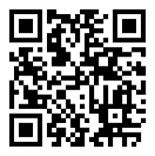
Satisfaction questionnaire

Slide 27
Thank you

